Slide 1
CyberMiner
Collin Matz
Fredrick Horn
Parker Tate
Conner Carraher
Joshua Brown
Pranit Konda
Jacob Danel
Team website: https://cs4376-team-a.github.io/Project/

Slide 2
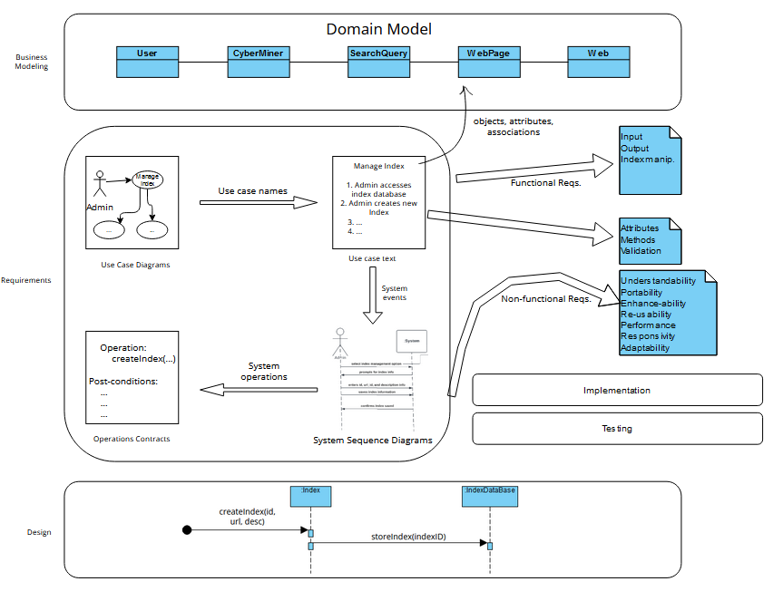
General Overview

Slide 3
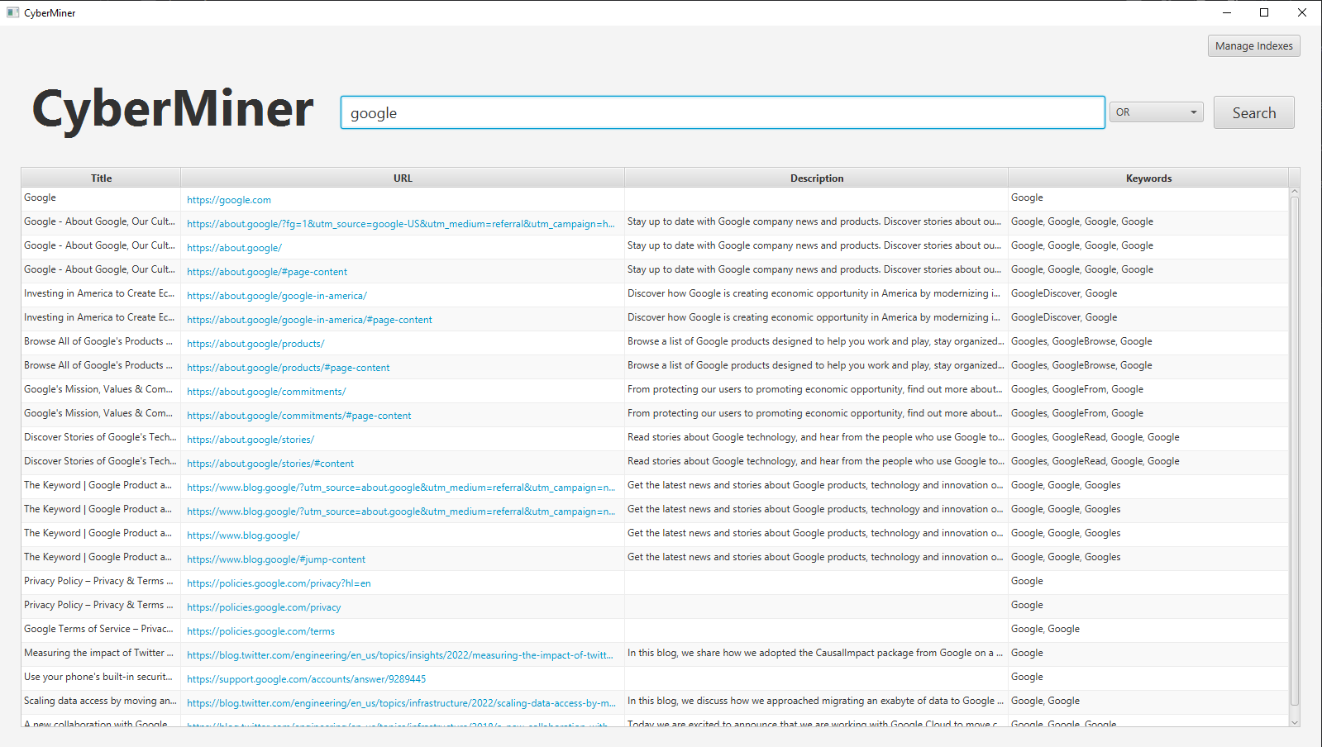
Demo

Slide 4
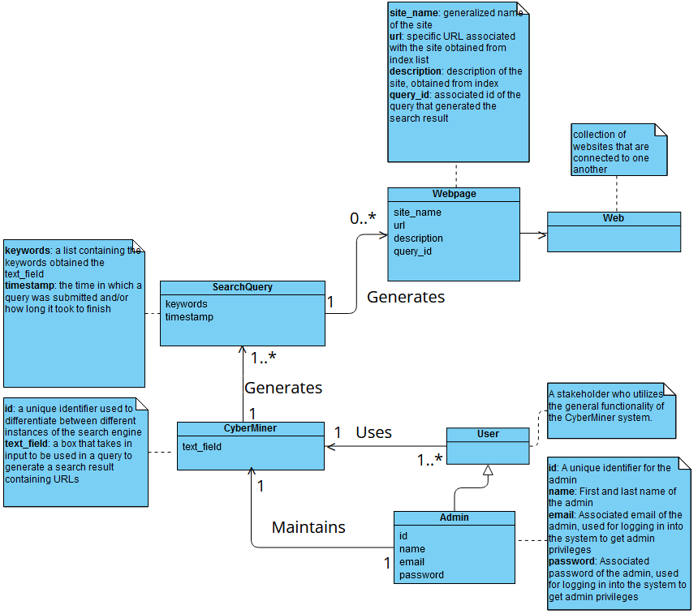
Domain Model
General layout of the system
Sequence of events?
Slight variations from phase 1
user is more generic now, no stored information
Admin must login to do their work
Rest of system mostly the same

Slide 5
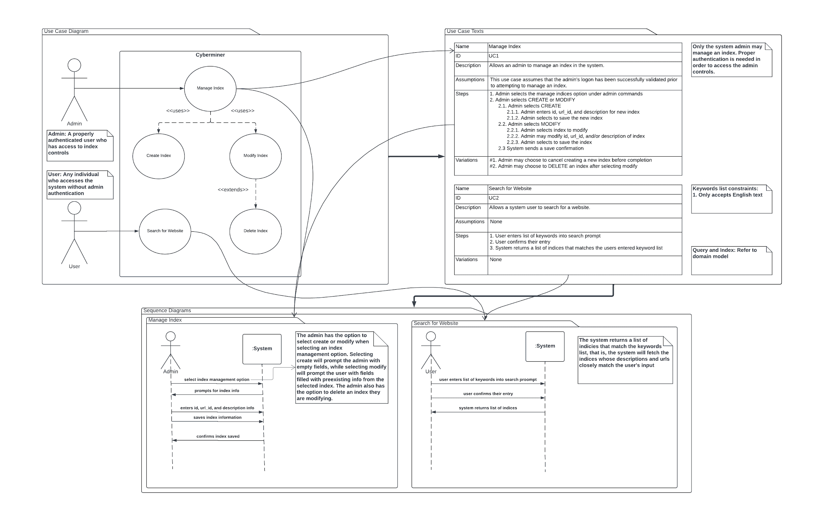
Requirements

Slide 6
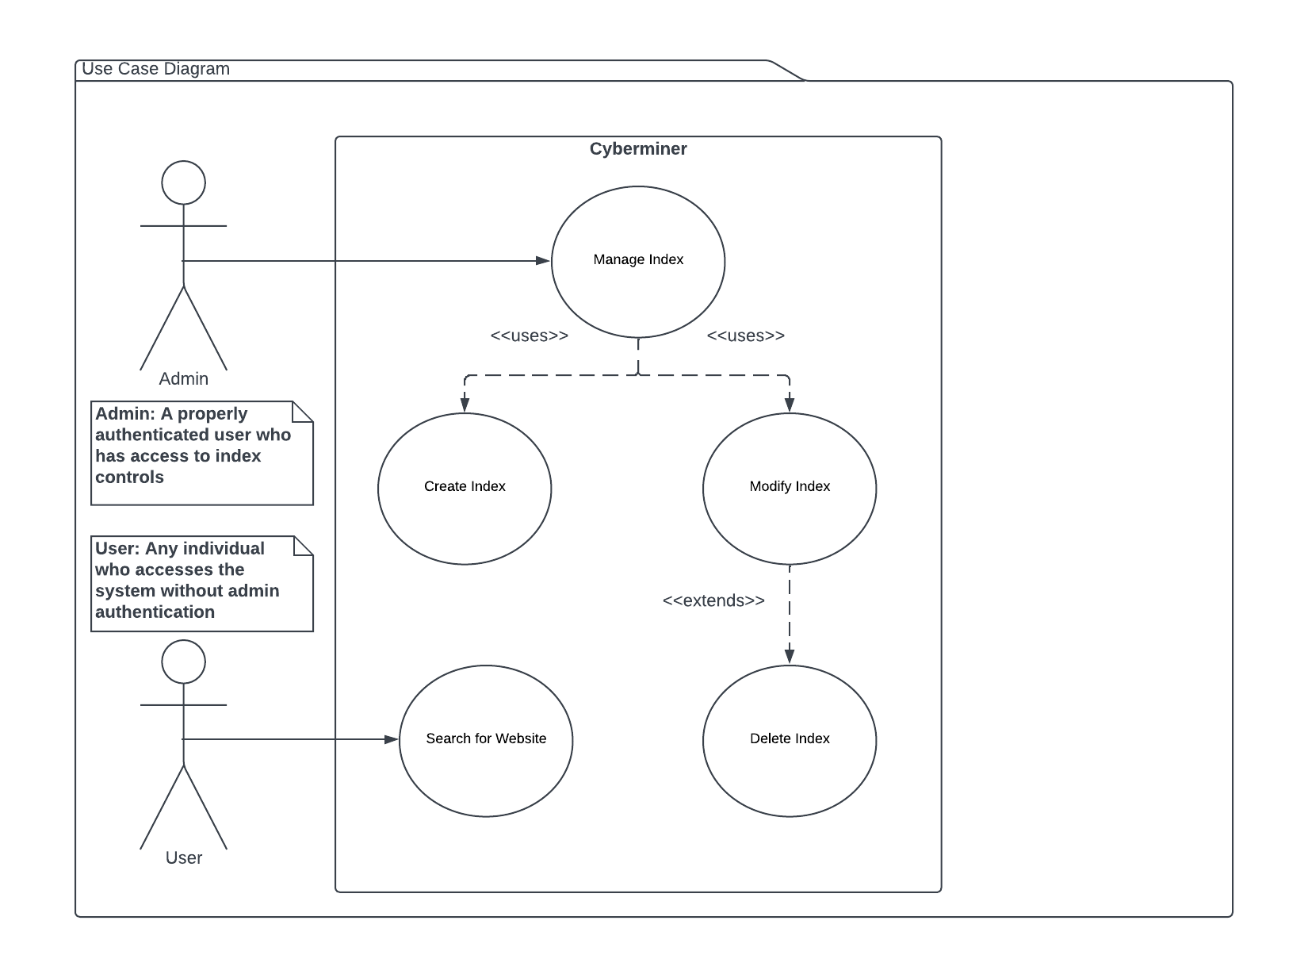
Use Cases

Slide 7
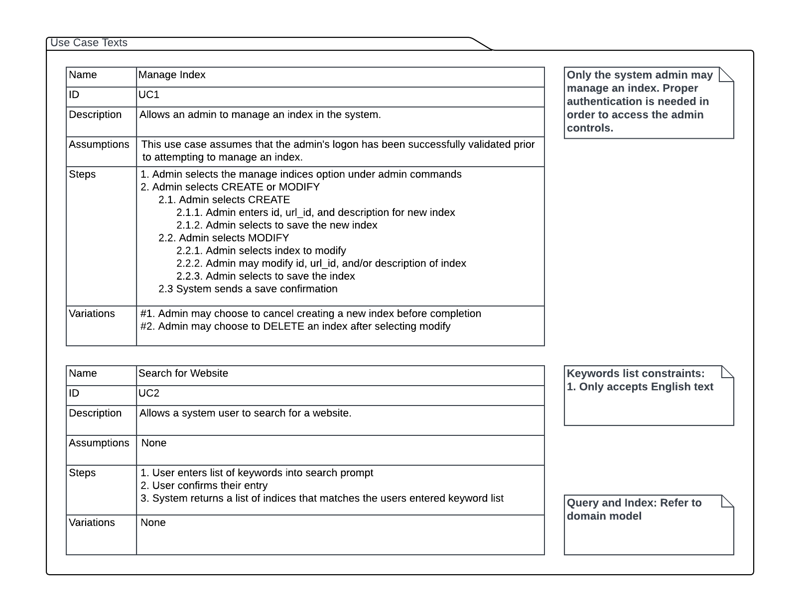
Use Cases Cont.

Slide 8
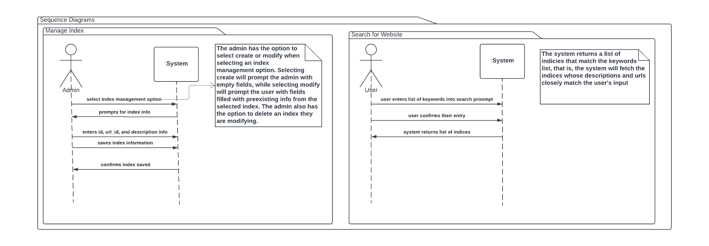
System Sequence Diagrams

Slide 9
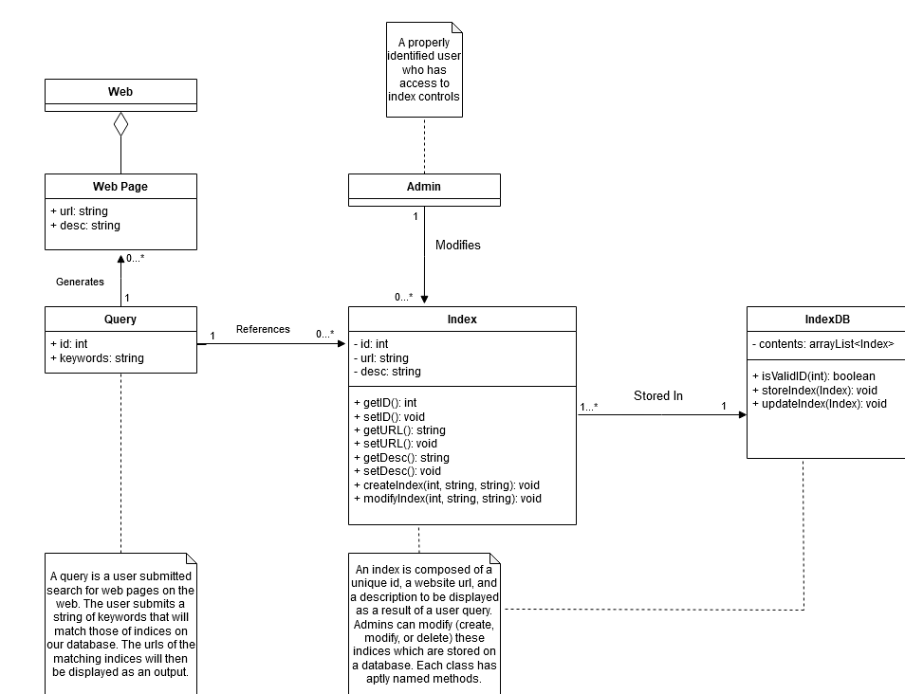
Design Model

Slide 10
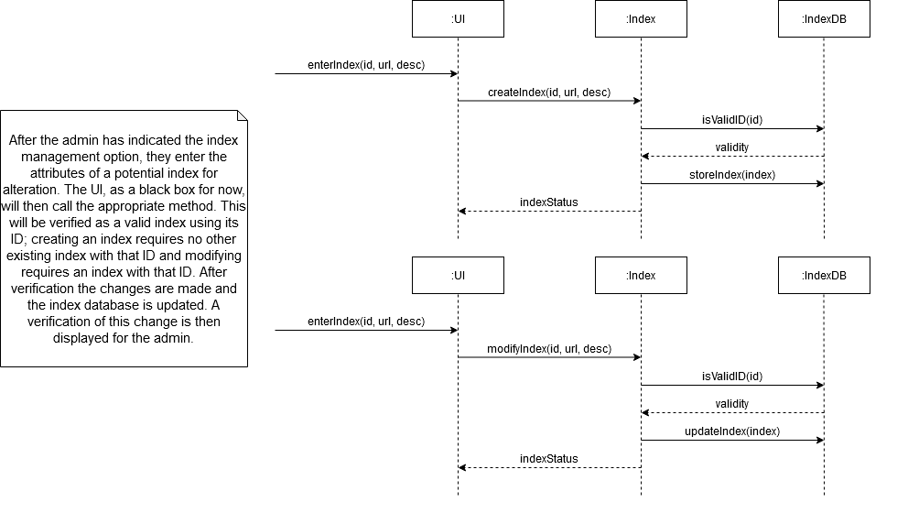
Design Model

Slide 11
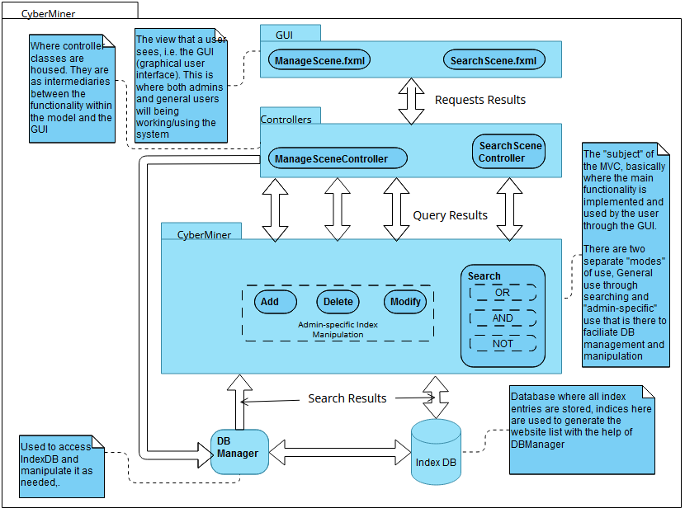
MVC - Model-View-Control Representation
CyberMiner generates scenes based on searches
Control is intermediary between functionality in the Model and the GUI in View
ManageSceneController is for DB management
SearchSceneController is for search functionality
Search scenes are displayed as one large page that shows every relevant website

Slide 12
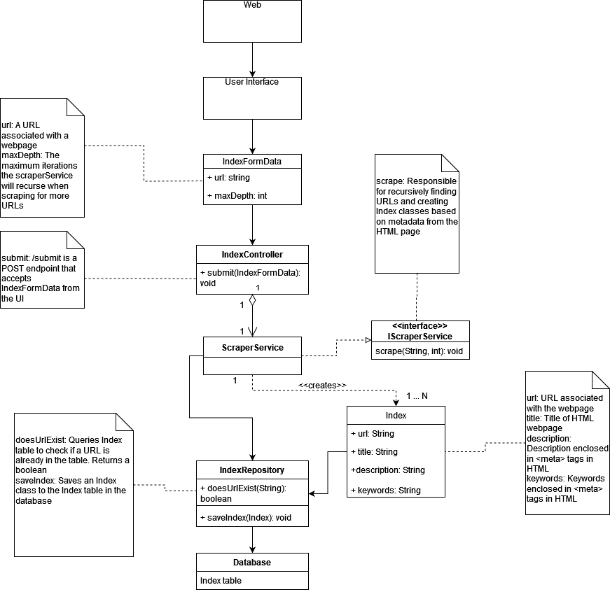
Implementation

Slide 13
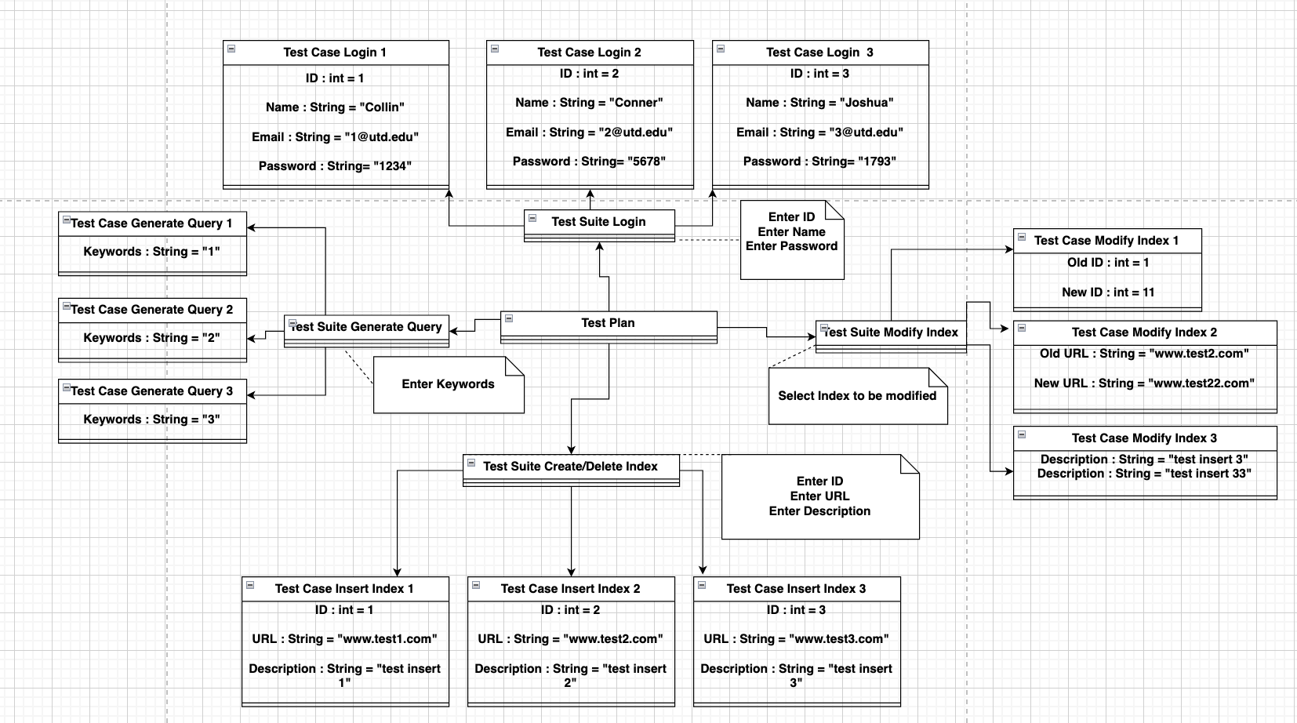
Testing

Slide 14
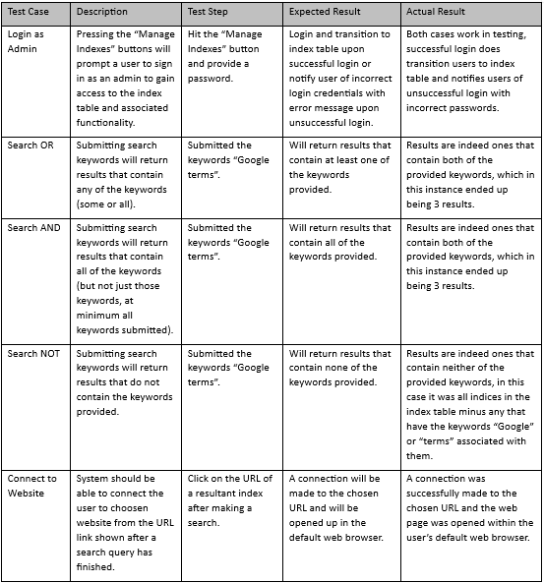
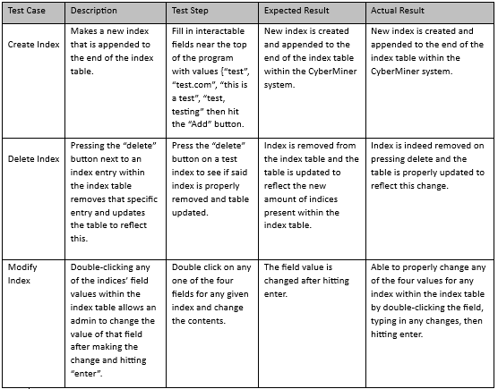
Test Cases with Results

